Slide 1
Tracking API Application
Using Trackship upstream API
Prepared by: Kruti Dhyani

Slide 2
Table of content
Introduction
Selection API
Get Third party API key steps
Project Documentation
Learnings

Slide 3
Introduction
This project demonstrate the use of Upstream tracking API in your application.
The Tracking Order API allows you to retrieve tracking information for orders using a provided order ID.
Advantage of Upstream API : Do not write functionality from the scratch.

Slide 4
Selection of API
1st
2
3
4
4
UPS
Trucktracker
fedex
Trackship
Ask Actual business application and Also ask credit card Details
API key is only valid for 24 hours then you have to generate API after every 24 hours
API key is only valid for 24 hours then you have to generate API after every 24 hours
No issue which I faced in past application So, Finally selected this

Slide 5
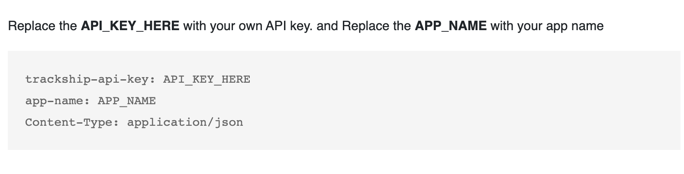
Get Trackship API key Steps
URL for Reading Trackship documentation: https://docs.trackship.com/docs/tracking-api/create-shipment/
Steps:
Sign Up to the trackship website.
You will get email authentication to your registered email
https://docs.trackship.com/docs/tracking-api/api-requests-authentication/ go to authentication documentation and follow the steps. Remember, it requires the given images information in your application as authentication header information.

Slide 6
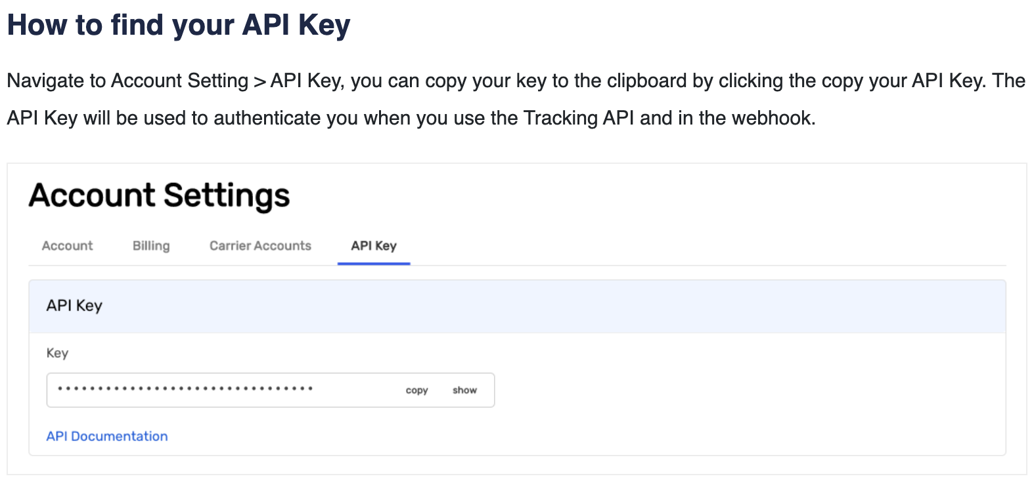
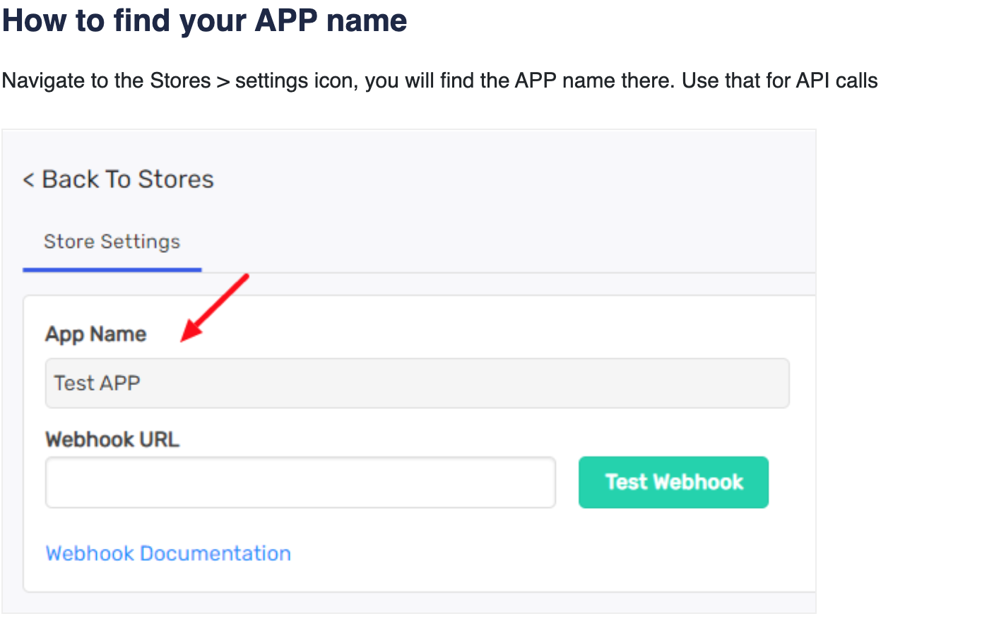
Get Trackship API key Steps cont
4. How to find API key from your account then go to :
https://my.trackship.com/ and follow the steps as the below screenshots
5. To set the app name follow the steps below images.
Do not necessarily use webhooks.
6. Done

Slide 7
Setting up the project and environment variable
NOTE: make sure your npm and node js is installed in your laptop
Setting up the project
Create a new Node.js project. Using npm init -y command
Install Express.js. Using npm install express command
Initialize a `.env` file to store API keys. In your project root folder create file with name .env
Setting up the variable
To Store Tracking API keys in the `.env` file. Insert two thing below mentioned.
From your https://my.trackship.com/ account Copy the Given API key to your .env file of your application. For example: apikey = <paste your API key>
Save your Given App name in your .env file of your application. For example : app_name=<your App name>

Slide 8
Project Documentation
My Application Documentation Link:
https://docs.google.com/document/d/1PCVo96jmhR1a84L4T1HQzx-qEHW8GWm1PZKzLmUf8Fk/edit

Slide 9
Learnings
Upstream API use
Reading the Third party Documentation and how to set the parameter to call third party api successfully.

Slide 10
Thank you

